Slide 1
Week 5 (10/9): An Algorithmic Criticism: Word-Level Text Analysis

Slide 2
Algorithmic Criticism
This work . . . Proposes that scientific method and metaphor [“scientism”] is, for the most part, incompatible with the terms of humanistic endeavor.
“Algorithmic criticism”—criticism derived from algorithmic manipulation of text . . . Text, transformed algorithmically as a means of gaining entry to the deliberately and self-consciously subjective act of critical interpretation.
Ramsay, Stephen. “Chapter 1: An Algorithmic Criticism.” In *Reading Machines: Toward an Algorithmic Criticism*, 1–17. Topics in the Digital Humanities. Urbana: University of Illinois Press, 2011.

Slide 3
current literary criticism
is skeptical of
authorial intention as a normative principle
linguistic meaning as a stable entity
interpretive objectivity or an unsituated reading
Operates within a hermeneutical framework in which fact, metric, verification, and evidence do not apply
Evaluates conclusions in terms of the nature and depth of the discussions that result
Ramsay, Stephen. “Chapter 1: An Algorithmic Criticism.” In *Reading Machines: Toward an Algorithmic Criticism*, 1–17. Topics in the Digital Humanities. Urbana: University of Illinois Press, 2011.

Slide 4
Algorithmic Criticism: Text Analysis
Represents a heuristic of radical transformation
Not just a new method in the digital space:
Must endeavor to assist the critic in the unfolding of interpretive possibilities
“evidence” that is suggestive of grander arguments and schemes
Ramsay, Stephen. “Chapter 1: An Algorithmic Criticism.” In *Reading Machines: Toward an Algorithmic Criticism*, 1–17. Topics in the Digital Humanities. Urbana: University of Illinois Press, 2011.

Slide 5
Algorithmic Criticism: Text Analysis
My favorite line:
“Just as one might undertake a feminist reading of a text by transporting a set of heuristics from one text to another, so might the algorithmic critic undertake a particular type of reading by transforming a procedure that has been defined in terms of the most modern text, the computer program.”
Ramsay, Stephen. “Chapter 1: An Algorithmic Criticism.” In *Reading Machines: Toward an Algorithmic Criticism*, 1–17. Topics in the Digital Humanities. Urbana: University of Illinois Press, 2011.

Slide 6
Algorithmic Criticism
Seeks a new kind of audience for text analysis – one that is less concerned with the fitness of the method and the determination of interpretative boundaries, and one more concerned with evaluating the robustness of the discussion that a particular procedure annunciates.
Ramsay, Stephen. “Chapter 1: An Algorithmic Criticism.” In *Reading Machines: Toward an Algorithmic Criticism*, 1–17. Topics in the Digital Humanities. Urbana: University of Illinois Press, 2011.

Slide 7
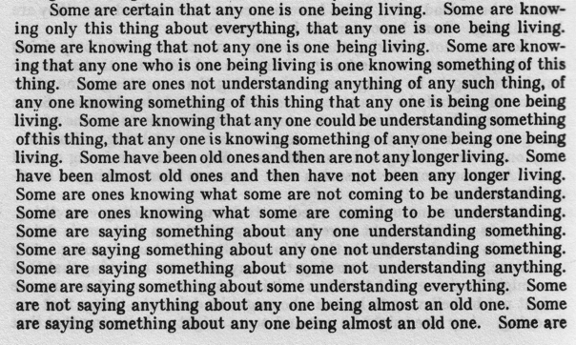
Algorithmic Criticism
The Making of Americans (Paris 1925) by Gertrude Stein

Slide 8
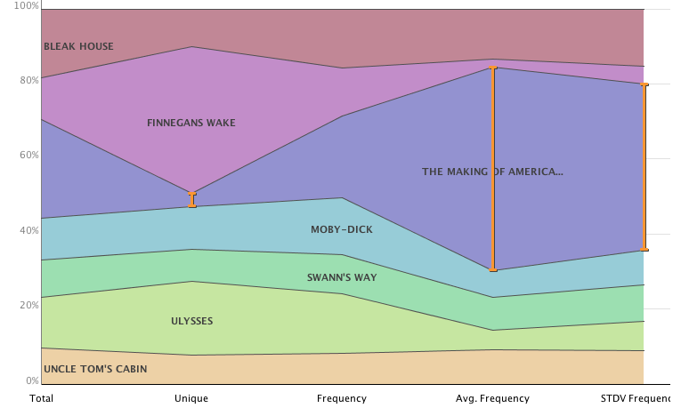
Algorithmic criticism: word frequencies– Text Arc
Notes:
Provide an overview.

Slide 9
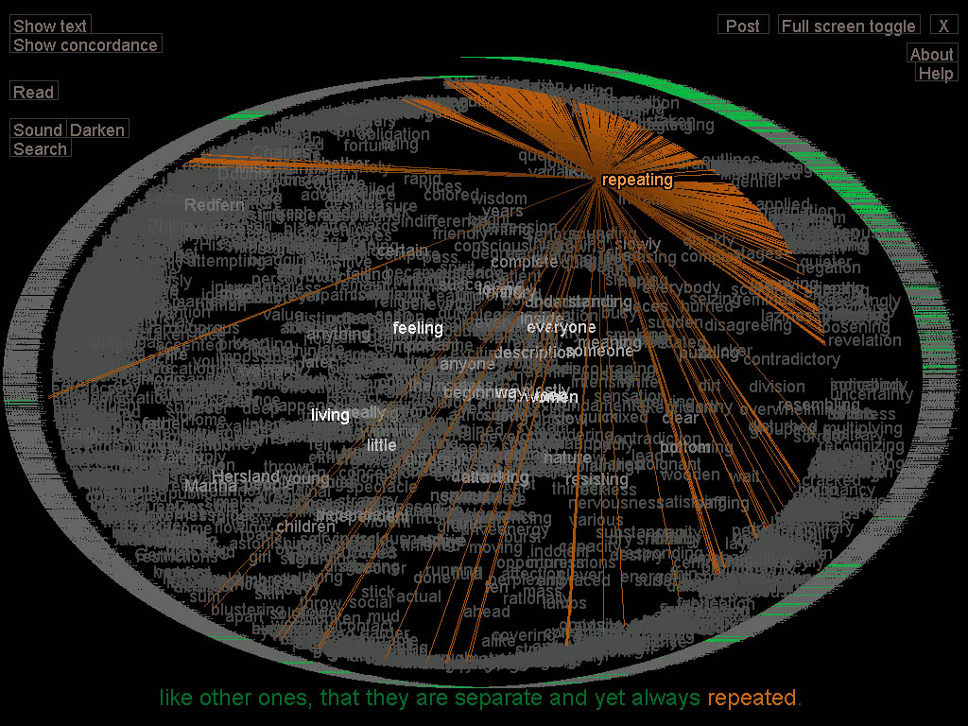
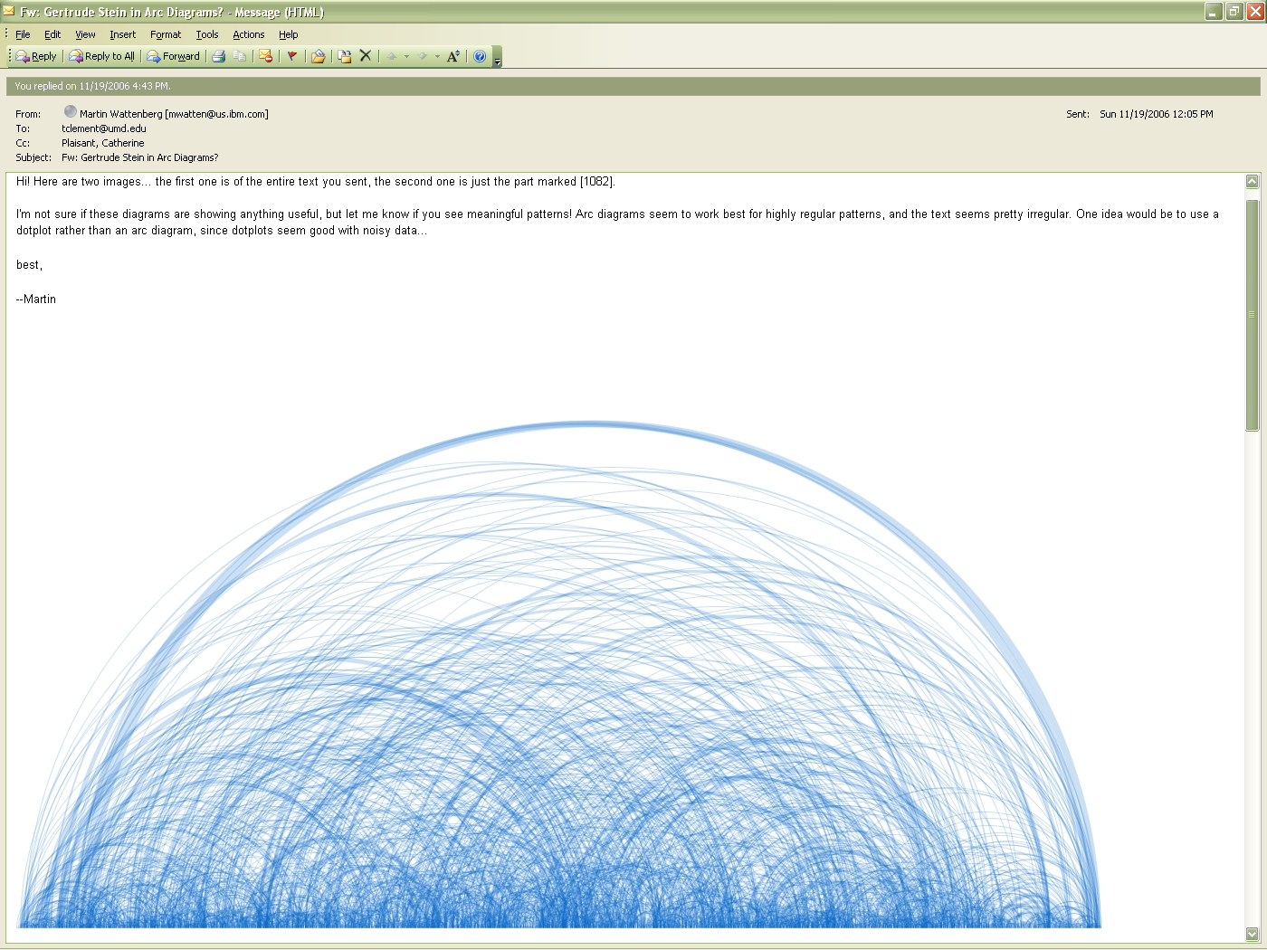
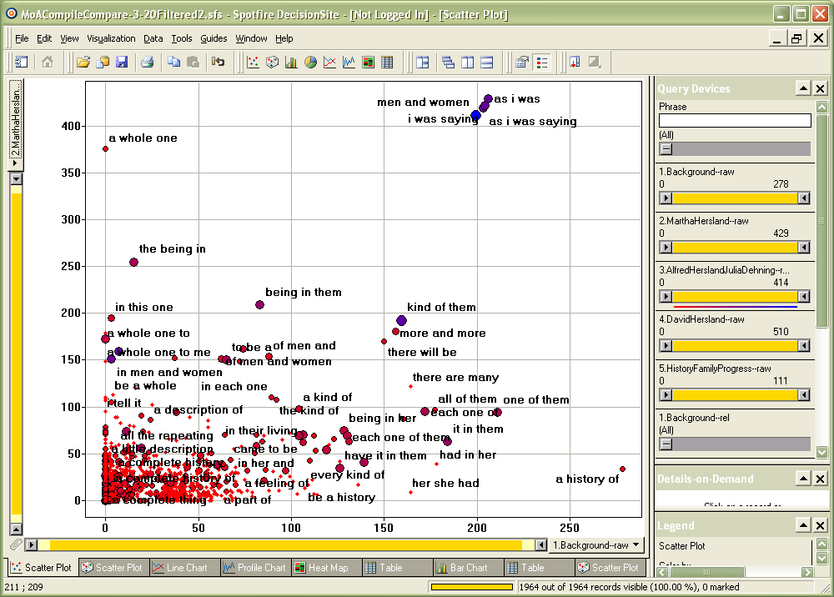
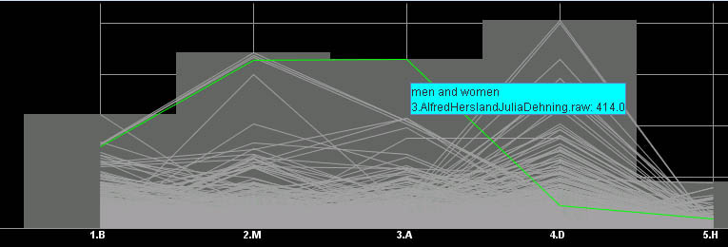
Algorithmic criticism: word frequencies– Text Arc
M. Wattenberg, Arc Diagrams
Brad Paley, TextArc
SpotFire
TimeSearcher
Notes:
Provide an overview.

Slide 10
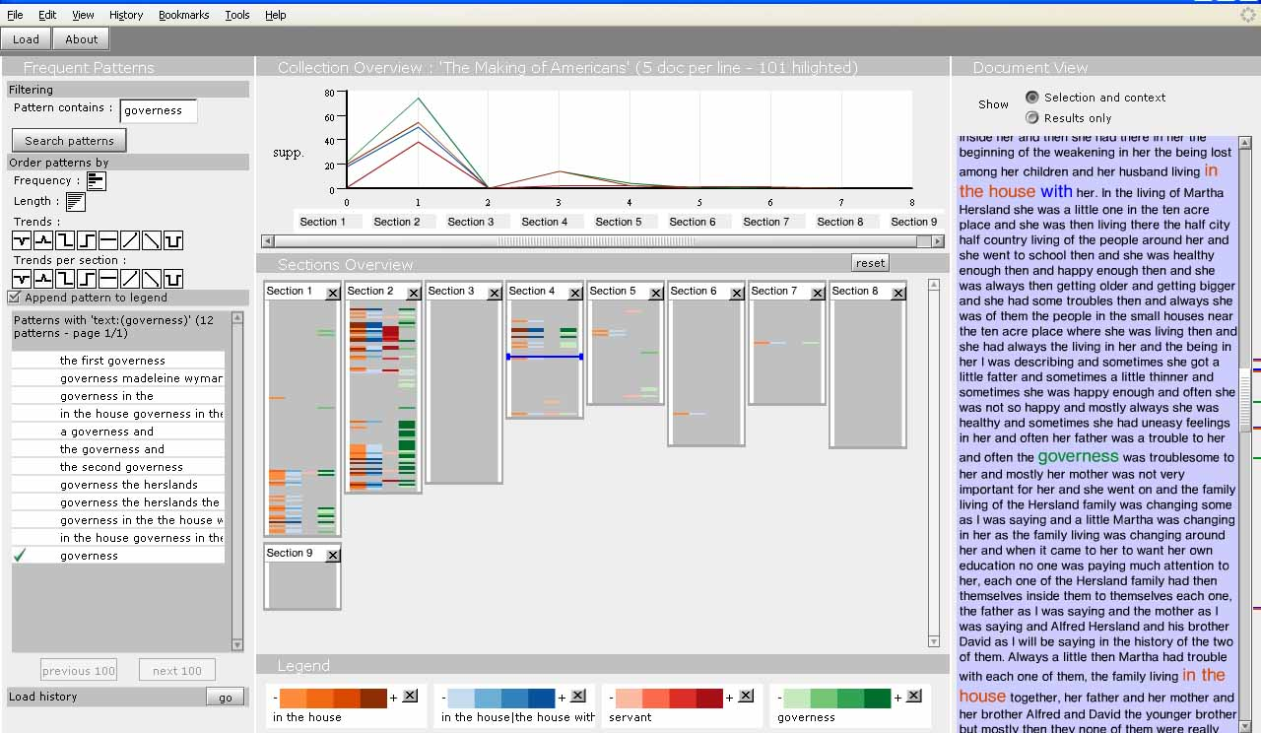
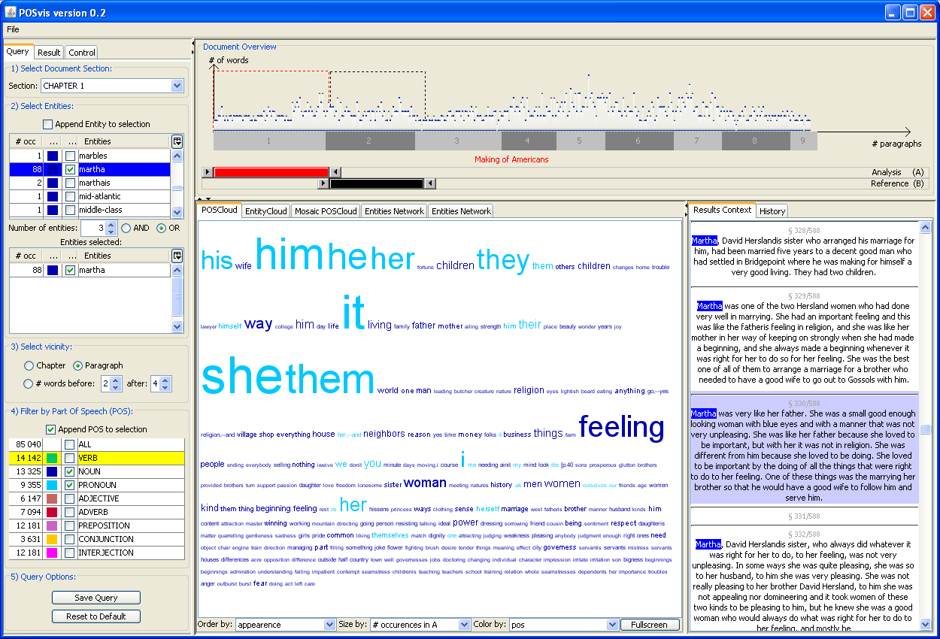
Tools for reading Algorithmic criticism
1: N-Grams, frequent pattern analysis
and FeatureLens
2: Repetition analysis and SpotFire
3: Word usage, Dunnings and PosViz
Notes:
Provide an overview.

Slide 11
FeatureLens
Algorithmic criticism: frequent pattern analysis
Created by Anthony Don, Catherine Plaisant and team at HCIL http://www.cs.umd.edu/hcil/textvis/featurelens/.

Slide 12
Algorithmic criticism: Ngram clustering Text Arc
n-gram : n consecutive words
example :
This is now a description of all of them.
Set of 3-grams:
{This is now}

Slide 13
Algorithmic criticism: Ngram clustering– Text Arc
n-gram : n consecutive words
example :
This is now a description of all of them.
Set of 3-grams:
{This is now, is now a}}

Slide 14
Algorithmic criticism: Ngram clustering– Text Arc
n-gram : n consecutive words
example :
This is now a description of all of them.
Set of 3-grams:
{This is now, is now a, now a description,
a description of, description of all,
of all of, all of them}

Slide 15
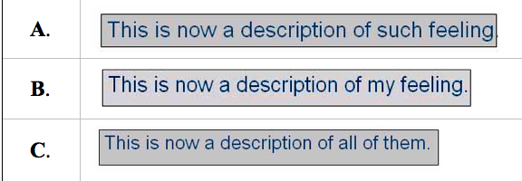
Algorithmic criticism: Ngram clustering– Text Arc
Four trigrams (“a description of,” “now a description,” “this is now,” and “is now a”) that co-occur in three different paragraphs (paragraphs 1076, 1080, and 1081)

Slide 16
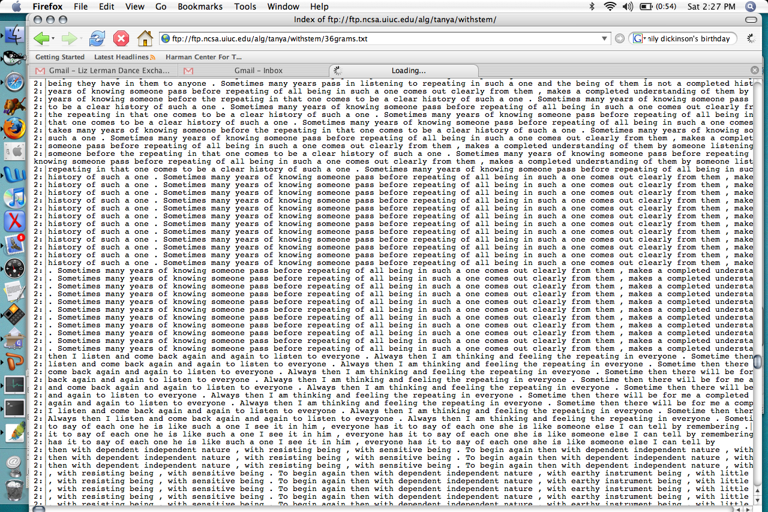
Algorithmic criticism: Ngram clustering– Text Arc
Text Mining Results: frequent patterns
clustering and classification (36 grams)

Slide 17
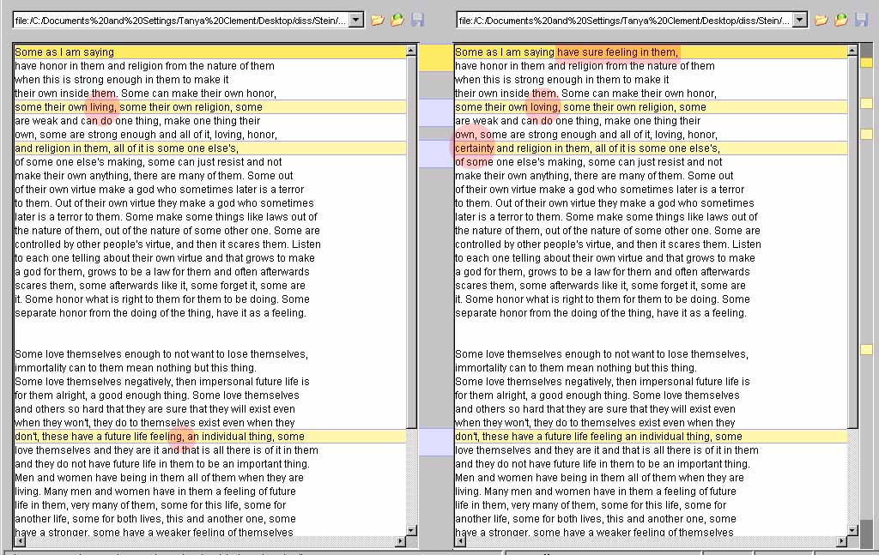
from Chapter 4
from Chapter 5
Two paragraphs from The Making of Americans

Slide 18
FeatureLens
Created by Anthony Don, Catherine Plaisant and team at HCIL http://www.cs.umd.edu/hcil/textvis/featurelens/.

Slide 19
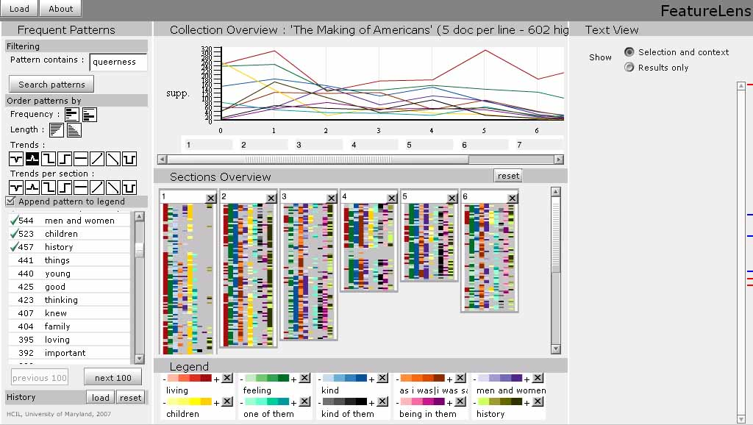

Slide 20
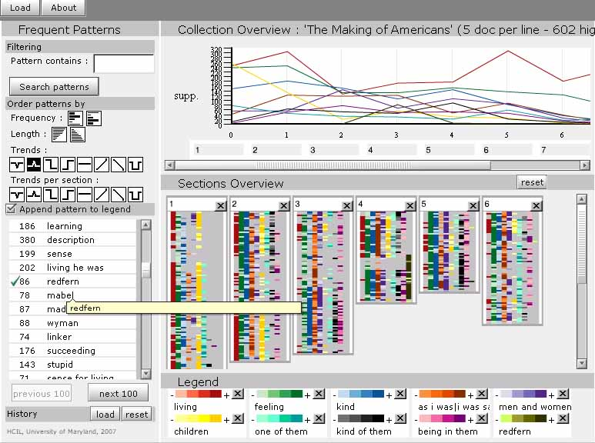
Trends?

Slide 21
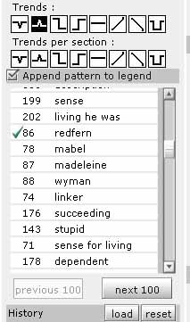

Slide 22
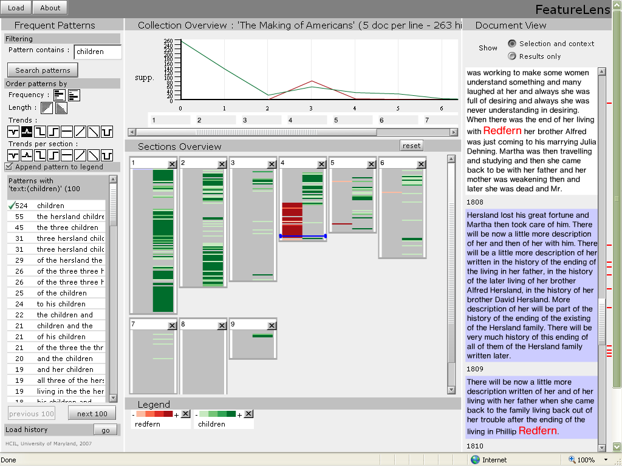

Slide 23
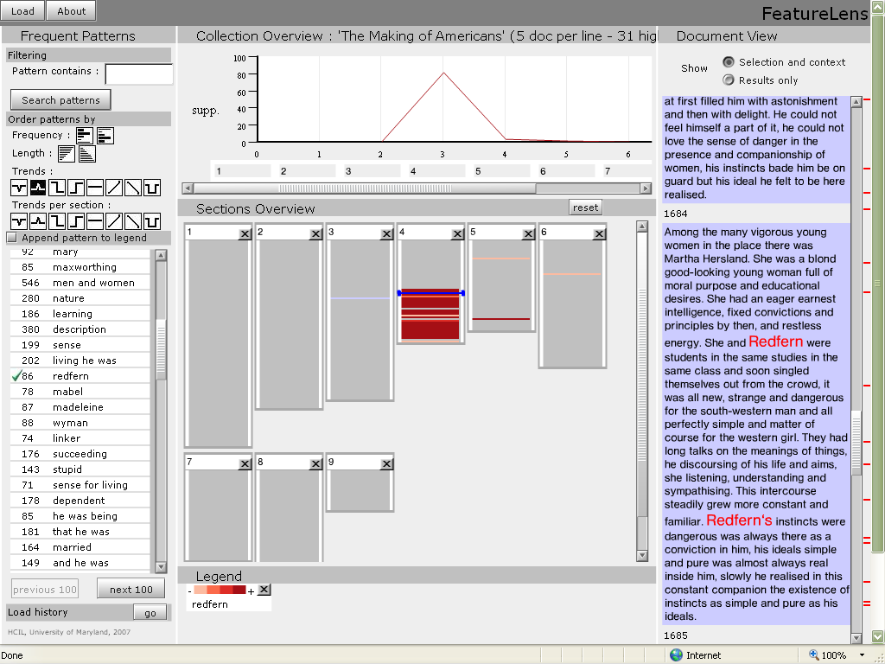
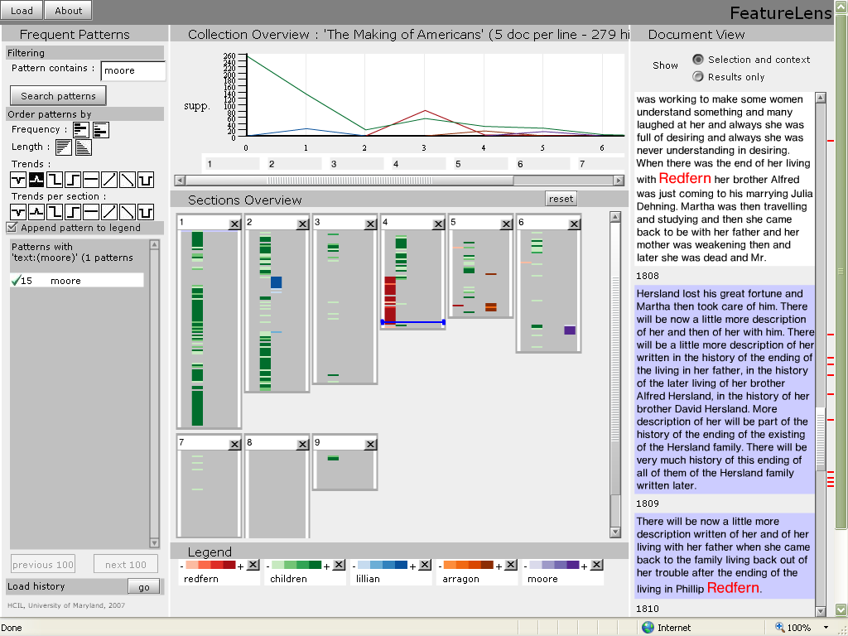

Slide 24
Algorithmic criticism: repetitions
… Any one is one not being a dead one. Any one is ¹one coming to be ²an old one. Any one is one being a dead one. Any one is one being such a one. Any one is ³one coming to be almost ²an old one.
Any one is one only not needing to be understanding everything. Any one is one who might have been doing the things that one is doing. Any one is one who might do that thing, the thing that one is doing… and some might be believing that that one has been doing what that one has been doing.
Any one might be ³one coming to be almost an old one. Any one might be ¹one coming to be an old one. Any one might be one coming to be a dead one.
Database of closed itemsets created by Craig Berry and Martin Mueller at Northwestern University
Notes:
Each item
in the database is an independently recurring string
within the text (including characters and punctuation)
that occurs at a specific location.20

Slide 25
Chapter | Location | ID | Length | Count | Repetition
9 | 1552162 | 137369 | 8 | 2 | an old one . Any one is one
9 | 1552192 | 137369 | 8 | 2 | an old one . Any one is one
9 | 1552187 | 137374 | 11 | 2 | one coming to be almost an old one . Any one
9 | 1552345 | 137374 | 11 | 2 | one coming to be almost an old one . Any one
9 | 1552358 | 137364 | 10 | 2 | one coming to be an old one . Any one
9 | 1552158 | 137364 | 10 | 2 | one coming to be an old one . Any one
9 | 1552189 | 137343 | 6 | 36 | to be almost an old one
9 | 1552023 | 137343 | 6 | 36 | to be almost an old one
9 | 1552347 | 137343 | 6 | 36 | to be almost an old one
9 | 1552192 | 94870 | 4 | 62 | an old one.
9 | 1552162 | 94870 | 4 | 62 | an old one.
Three repeated phrases in the database, along with “subset” strings:

Slide 26
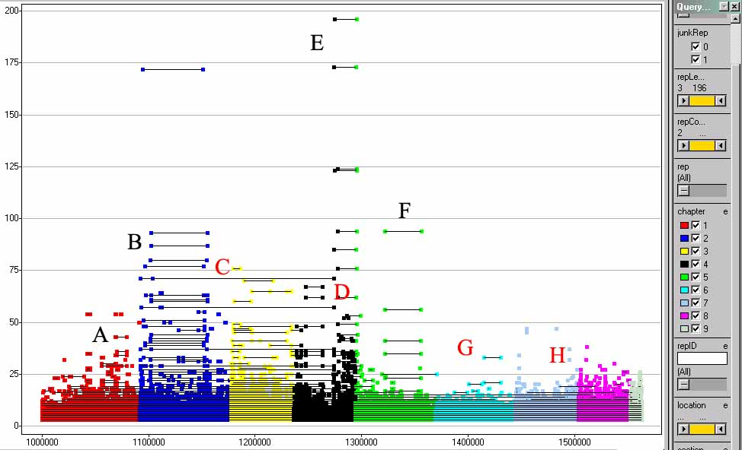
Length
Location
Repetitions from all 9 chapters of MoA in Spotfire

Slide 27
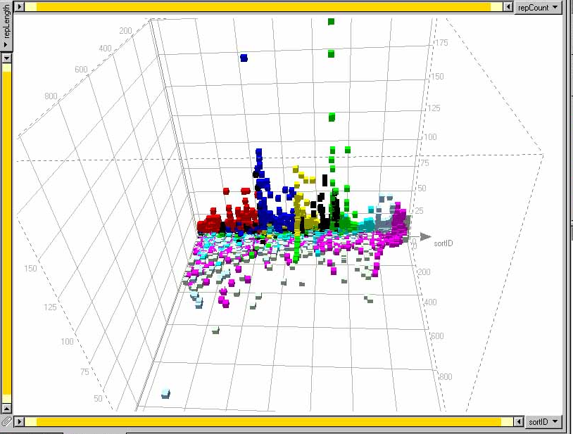
Length
Location
Frequency
Repetitions from all 9 chapters of MoA in Spotfire

Slide 28
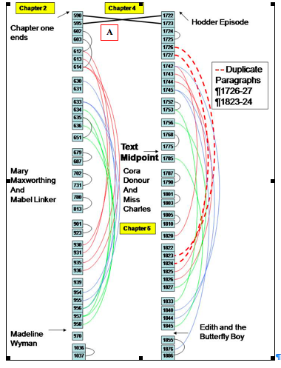
Flow chart of two cycles of repetitive patterns, PowerPoint

Slide 29
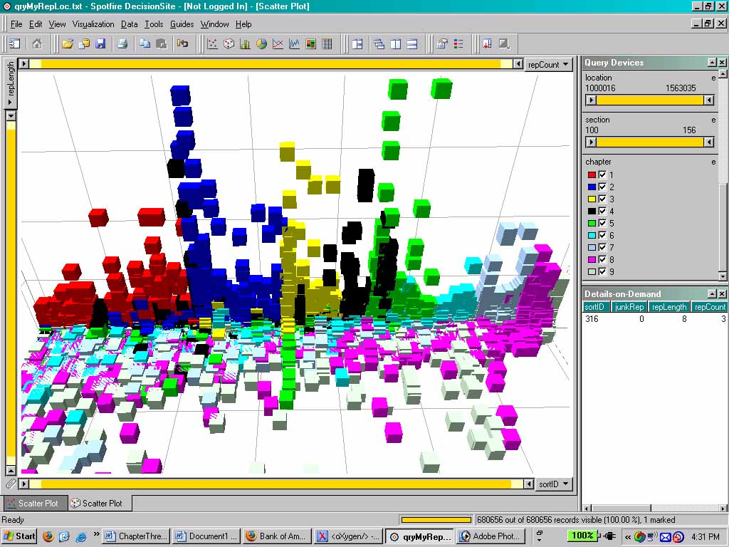
Length
Location
Frequency
Repetitions from all 9 chapters of MoA in Spotfire

Slide 30
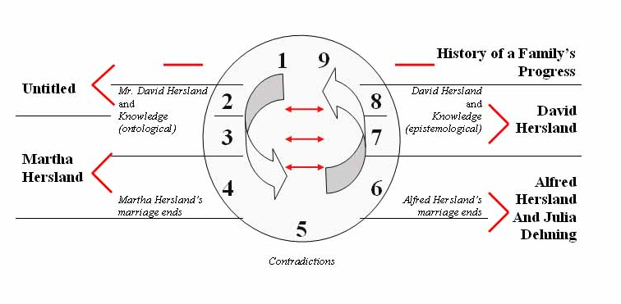
The Making of Americans as a ring composition

Slide 31
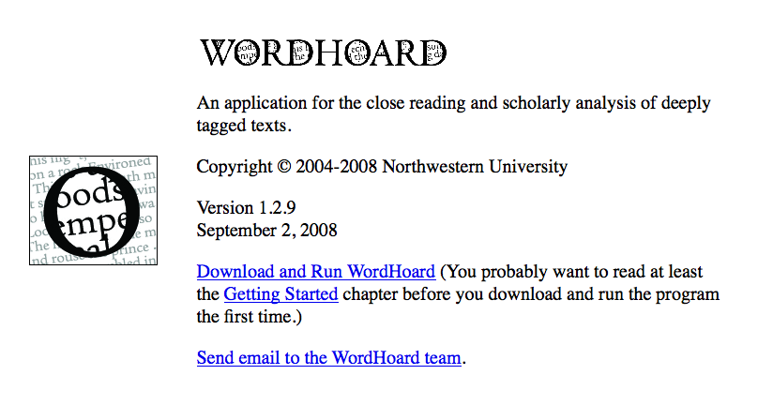
Dunning’s log likelihood analysis
http://wordhoard.northwestern.edu/userman/

Slide 32
. . . The Dickens characters, the George Eliot characters, the Meredith characters. They were more real to the average human being than the people they knew.
--Gertrude Stein, “Transatlantic Interview 1946”
Jane Austen: Pride and Prejudice, Mansfield Park, Emma: A Novel, Northanger Abbey, Persuasion, Lady Susan Watsons, and Sanditon
Charles Dickens: The Posthumous Papers of the Pickwick Club, Oliver Twist, Life and Adventures of Nicholas Nickleby, Barnaby Rudge, Old Curiosity Shop, A Christmas Story, Life and Adventures of Martin Chuzzlewit, Dombey and Son, The Personal History of David Copperfield, Bleak House, Hard Times, Little Dorrit, A Tale of Two Cities, Great Expectations, Our Mutual Friend, and The Mystery of Edwin Drood
George Eliot: Scenes of Clerical Life, Adam Bede, The Mill on the Floss, Silas Marner, Romola, Felix Holt, Middlemarch, and Daniel Deronda
George Meredith: The Ordeal of Richard Feverel, Evan Harrington, Beauchamp's Career, The Egoist, Diana of the Crossways, and One of Our Conquerors

Slide 33
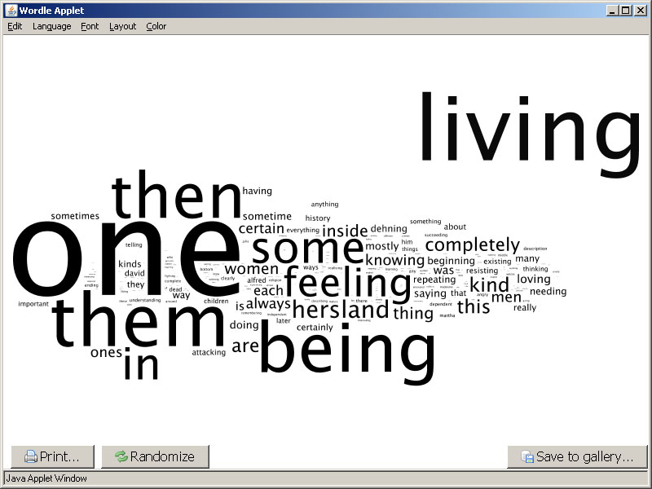
Austen : Less
Wordle
Words that are LESS frequent in novels by Austen (with common words)

Slide 34
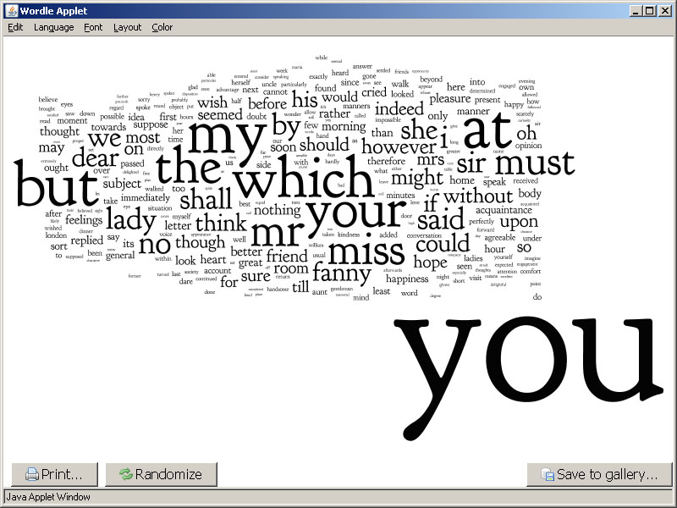
Austen: More
Wordle
Wordle
Words that are MORE frequent in novels by Austen (with common words)

Slide 35
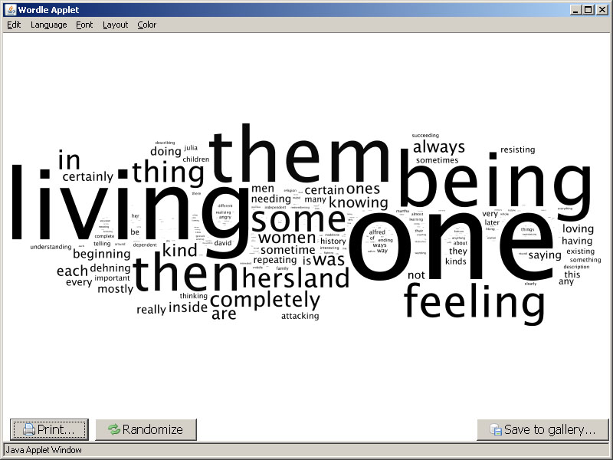
Dickens : Less
Wordle
Words that are LESS frequent in novels by Dickens (with common words)

Slide 36
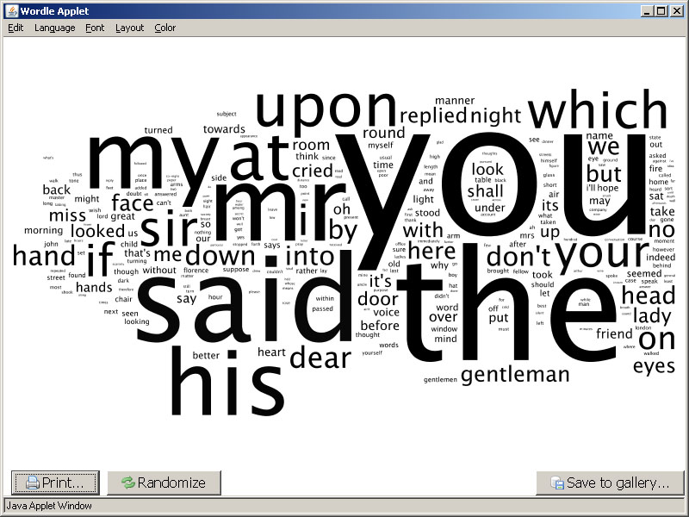
Dickens : More
Wordle
Words that are MORE frequent in novels by Dickens (with common words)

Slide 37
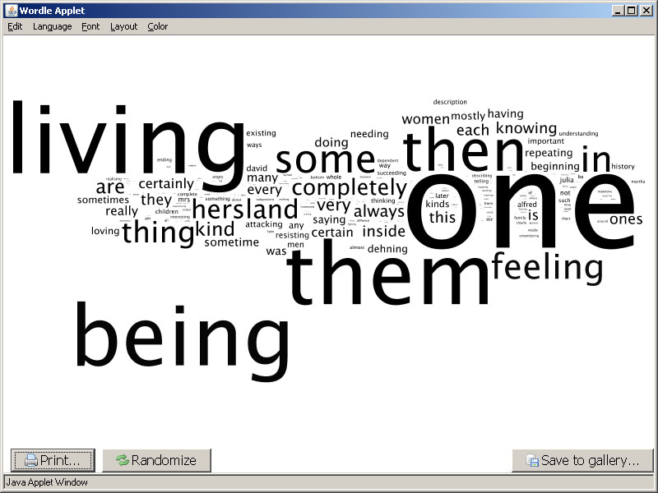
Eliot : Less
Wordle
Words that are LESS frequent in novels by Eliot (with common words)

Slide 38
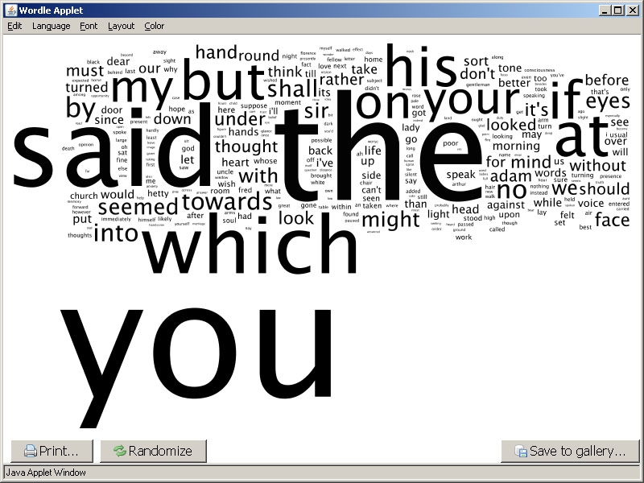
Eliot : More
Wordle
Words that are MORE frequent in novels by Eliot (with common words)

Slide 39
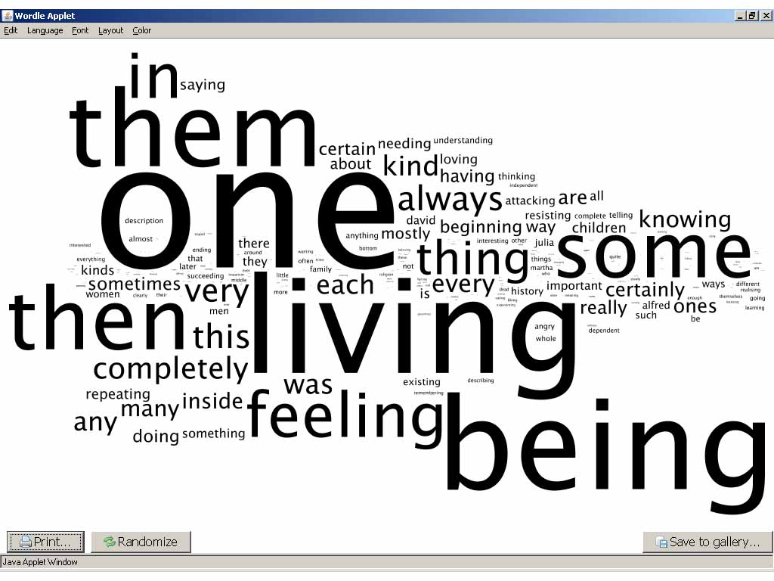
Meredith : Less
Wordle
Words that are LESS frequent in novels by Meredith (with common words)

Slide 40
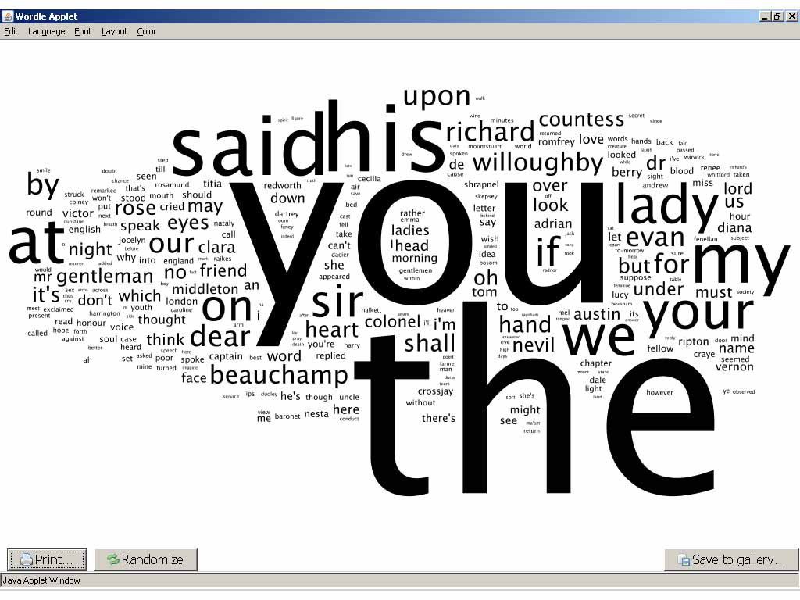
Meredith : More
Wordle
Words that are MORE frequent in novels by Meredith (with common words)

Slide 41
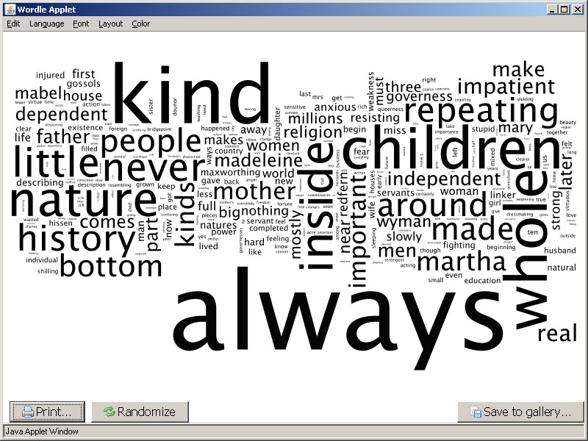
1-5 : More
Wordle
Words that are MORE common in chapters 1-5

Slide 42
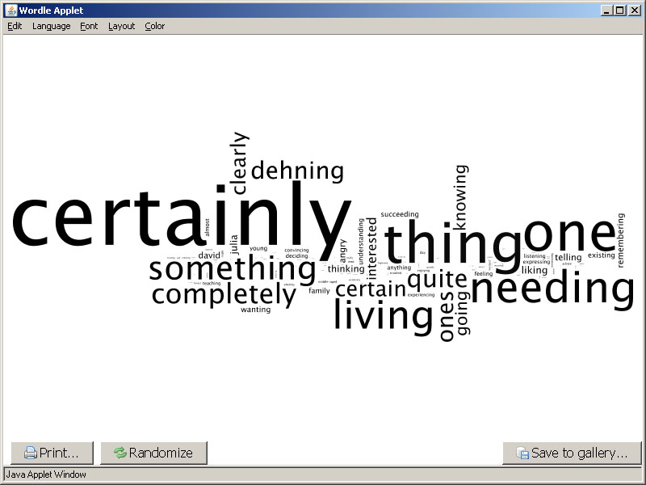
1-5 : Less
Wordle
Words that are LESS common in chapters 1-5

Slide 43
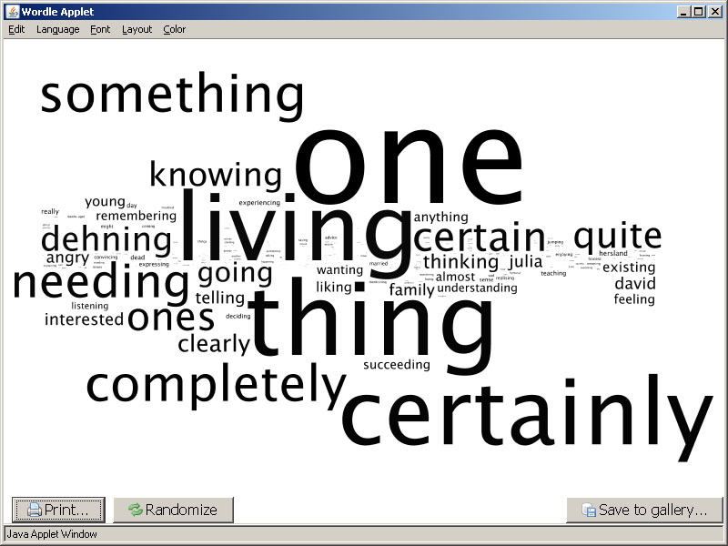
6-9 : More
Wordle
Words that are MORE common in chapters 6-9

Slide 44
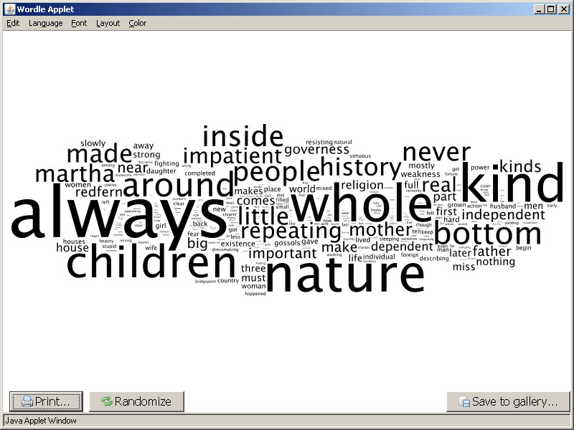
6-9 : Less
Wordle
Words that are LESS common in chapters 6-9

Slide 45
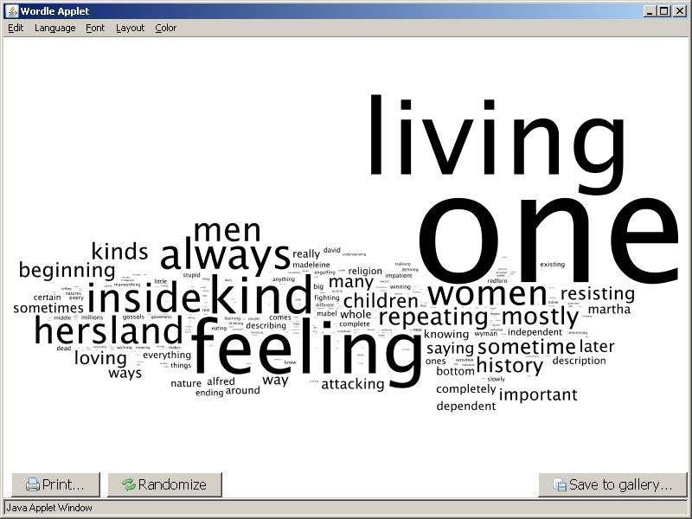
1-5 vs. Austen : Less
Wordle
1-5_Words that are LESS frequent in novels by Austen

Slide 46
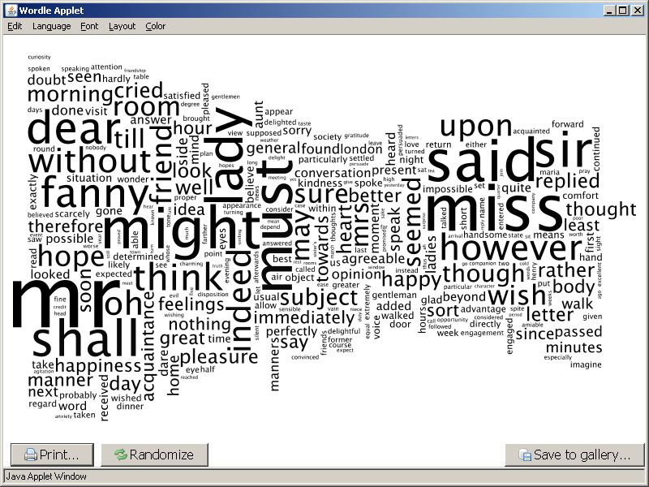
1-5 vs. Austen : More
Wordle
1-5_Words that are MORE frequent in novels by Austen

Slide 47
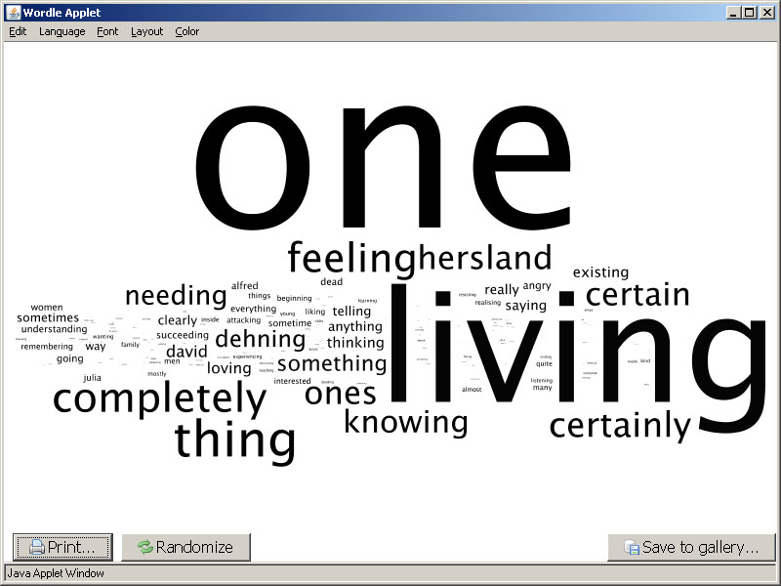
6-9 vs. Austen : Less
Wordle
6-9_Words that are LESS frequent in novels by Austen

Slide 48
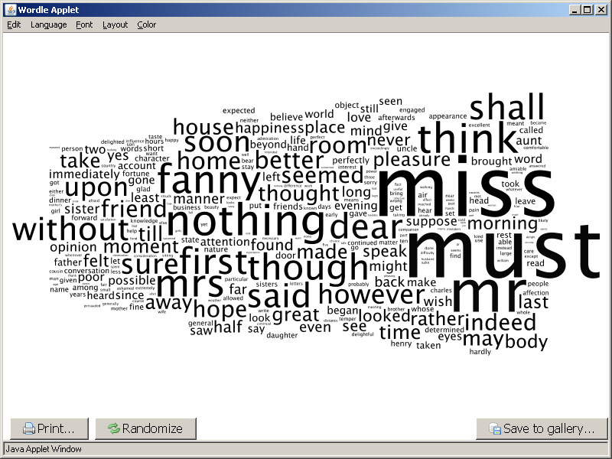
6-9 vs. Austen : More
Wordle
6-9_Words that are MORE frequent in novels by Austen

Slide 49
“One” in The Making of Americans
One is a young one and is knowing that one is not a young one and is knowing that one is a young one. One is an older one and is knowing that one is an older one and is knowing that one is not an older one. One is a middle-aged one and is knowing that one is a middle-aged one and is knowing that one is not a middle-aged one. One is an older one and is knowing that one is a middle-aged one and is knowing that one is not a middle-aged one. One is an older one and is knowing that one is not an older one and is knowing that one is an old one. (p. 807)

Slide 50
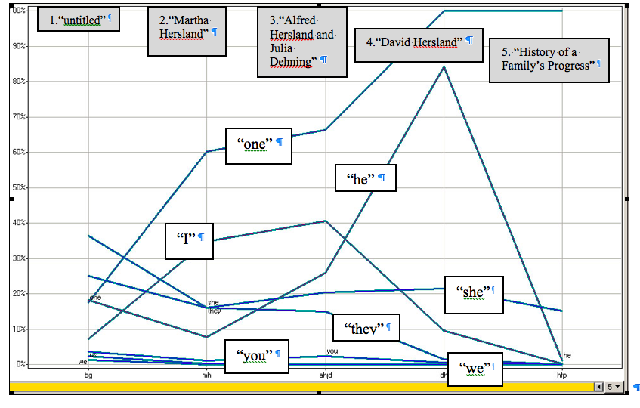
Frequencies mapped across the text’s five sections in Spotfire

Slide 51
Algorithmic criticism: word usage
Jane Austen: Pride and Prejudice, Mansfield Park, Emma: A Novel, Northanger Abbey, Persuasion, Lady Susan Watsons, and Sanditon
Charles Dickens: The Posthumous Papers of the Pickwick Club, Oliver Twist, Life and Adventures of Nicholas Nickleby, Barnaby Rudge, Old Curiosity Shop, A Christmas Story, Life and Adventures of Martin Chuzzlewit, Dombey and Son, The Personal History of David Copperfield, Bleak House, Hard Times, Little Dorrit, A Tale of Two Cities, Great Expectations, Our Mutual Friend, and The Mystery of Edwin Drood
George Eliot: Scenes of Clerical Life, Adam Bede, The Mill on the Floss, Silas Marner, Romola, Felix Holt, Middlemarch, and Daniel Deronda
George Meredith: The Ordeal of Richard Feverel, Evan Harrington, Beauchamp's Career, The Egoist, Diana of the Crossways, and One of Our Conquerors
. . . The Dickens characters, the George Eliot characters, the Meredith characters. They were more real to the average human being than the people they knew.
--Gertrude Stein, “Transatlantic Interview 1946”

Slide 52
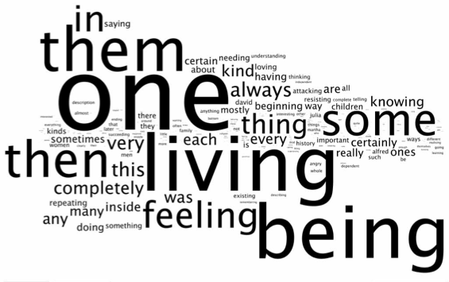
Algorithmic criticism: word usage– Text Arc
http://www.wordle.net/
Notes:
Provide an overview.

Slide 53
Algorithmic criticism: word usage; PosViz
Created by Romain Vuillemot, Catherine Plaisant, and Tanya Clement, HCIL http://www.cs.umd.edu/hcil/textvis/posvis/

Slide 54
Algorithmic criticism: articles–
Clement, Tanya. 2008. ‘A thing not beginning or ending’: Using Digital Tools to Distant-Read Gertrude Stein's The Making of Americans. Literary and Linguistic Computing 23, no. 3: 361-382.
Clement, Tanya. 2011. Text mining, Visualizations, and Online Social Networks—Critical Trends in Literary Scholarship? In Literary Studies in a Digital Age: A Methodological Primer, ed. Kenneth Price and Ray Siemens. New York: Modern Language Association (under contract).
Clement, Tanya. n.d. The Story of One: the Rhetoric of Narrative and Composition in The Making of Americans by Gertrude Stein. Cohen, Matt and Hinrichs, Lars (eds.). Linguistics and Literary Studies: Computation and Convergence. Special issue, Texas Studies in Language and Literature (2011).

Slide 55
Why sound? Why Gertrude Stein? What do Stein scholars do now?
The tools and methodologies: Meandre and ProseVis
Readings of poetry and prose by Stein

Slide 56
“. . . you see I feel with my eyes and it does not make any difference to me what language I hear, I don’t hear a language, I hear tones of voices and rhythms, but with my eyes I see words and sentences . . .”
Stein, Gertrude. The Autobiography of Alice B. Toklas. Vintage Books ed. New York: Vintage Books, 1990: 70. Print.

Slide 57
Orality vs. Aurality
“Orality can be understood as a stylistic or even ideological marker or a reading style . . . By aurality, I mean to emphasize the sounding of the writing, and to make a sharp contrast with orality and its emphasis on breath, voice, and speech . . .Aurality precedes orality, just as language precedes speech.”
Bernstein, C. 1998. Close Listening: Poetry and the Performed Word. Oxford University
Press: 13.

Slide 58
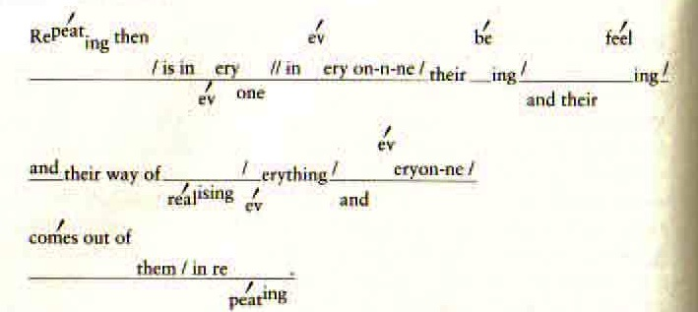
Meyer, Steven. Irresistible Dictation: Gertrude Stein and the Correlations of Writing and Science. Stanford, Calif: Stanford University Press, 2001. Print.

Slide 59
Sentences from “Miss Furr and Miss Skeene” visualized by composer Linda Dusman

Slide 60
Previous DH Work on Phonetic Symbolic Research
Marc Plamondon created AnalysePoems to analyze the Representative Poetry Online (RPO) website (http://rpo.library.utoronto.ca)(Plamondon, 2006, 129)
Pattern-Finder : a tool to examine how the “phonetic/phonological structure of a poem may contribute to its meaning and emotional power” (Smolinsky and Sokoloff , 2006, 339)
Marc Alexander and Christian Kay’s “Digital Approach to Sound Symbolism” in The Historical Thesaurus of English (here, now)

Slide 61
The surrogate of sound
We are defining sound as the pre-speech promise of sound as it is signified within the structure and syntax of text. This structure and syntax serves as the surrogate of sound’s potential to be heard and understood.

Slide 62
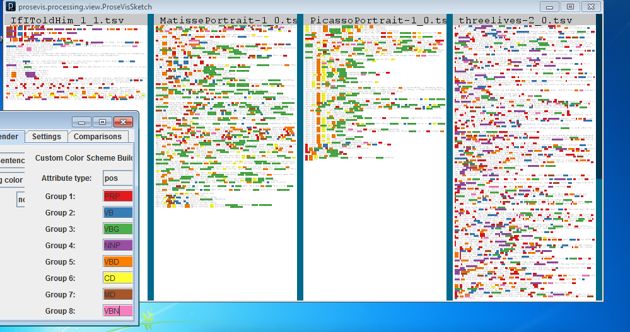
ProseVis
http://tclement.ischool.utexas.edu/ProseVis

Slide 63
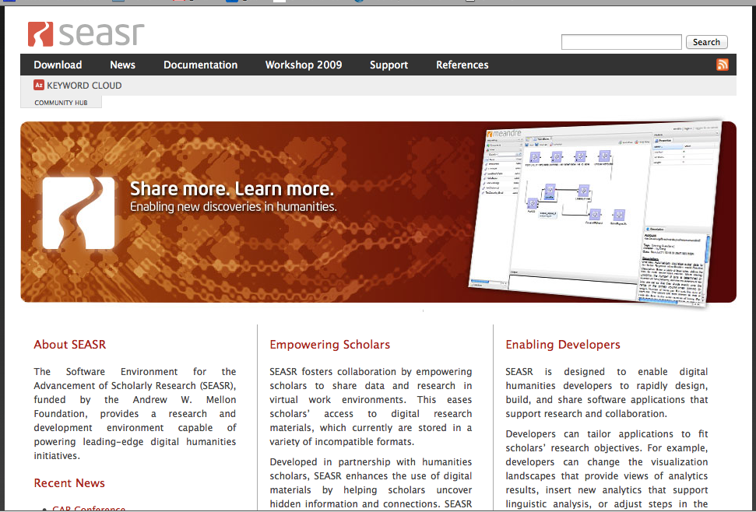
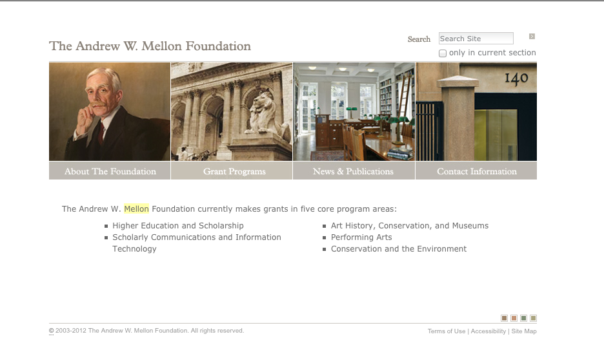
The Software Environment for the Advancement of Scholarly Research http://seasr.org/
The Andrew G. Mellon Foundation
http://www.mellon.org/

Slide 64
Developing ProseVis: the back(end) story
OpenMary (Modular Architecture for Research on speech sYnthesis) (http://mary.dfki.de/)
SEASR services to perform clustering and predictive modeling on this pre-processed text (http://seasr.org/)
ProseVis (http://tclement.ischool.utexas.edu/ProseVis)

Slide 65
Modular Architecture for Research on speech sYnthesis (MARY)
Text-to-speech system, developed as a collaborative project of Das Deutsche Forschungszentrum für Künstliche Intelligenz (German Research Center for Artificial Intelligence) Language Technology Lab and the Institute of Phonetics at Saarland University
Uses CMU [Carnegie Mellon University] Pronouncing Dictionary, North American English and General American
Produces XML that includes these fields for each word: part_of_speech, accent, phoneme, tone, break_index (phrase, sentence, paragraph) .

Slide 66
MARY’s Best Guess
Part of speech
Position in the sentence
Sentence type
Various aspects of syntactic structure (e.g., verb after a verb or multiple nouns)
Information structure (e.g., given and inferable information is frequently de-accented)
Becker S., Shröder M., and Barry, W. 2006. “Rule-based Prosody Prediction for
German Text-to-Speech Synthesis”

Slide 67
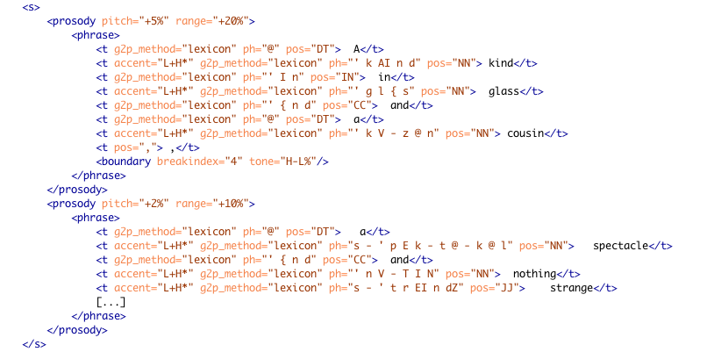
Mary’s Best Guess
Open Mary's Text-to-speech system (http://mary.dfki.de/)

Slide 68
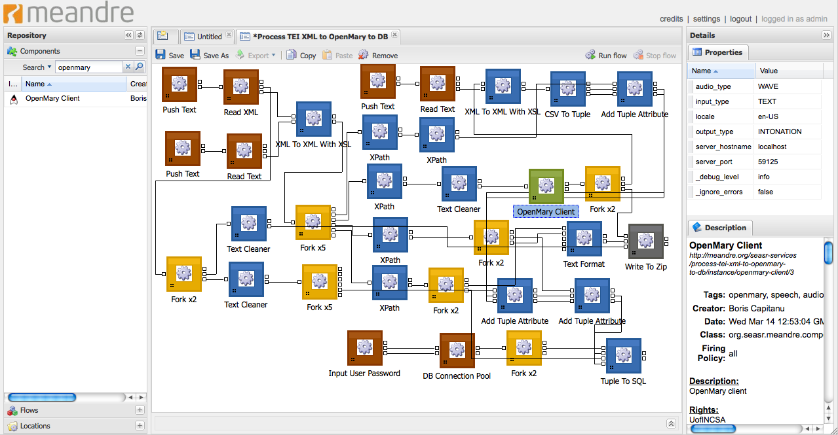
Seasr’s Meandre Data Flow Environment
Notes:
Green components are for computing (i.e. OpenMary processing), the blue components are transformation components (i.e. XSL transformation), the red components are input components (i.e. loading the xml file), the dark gray component is an output component (i.e. writing a file) and the yellow component are control flow components, (i.e. forking - duplicating an output). Another benefit of creating this flow in Meandre is that readers who wish to analyze these results or who wish to produce data for their documents will have access to the same flow. This flow and ProseVis are available for trial at http://tclement.ischool.utexas.edu/ProseVis/.

Slide 69
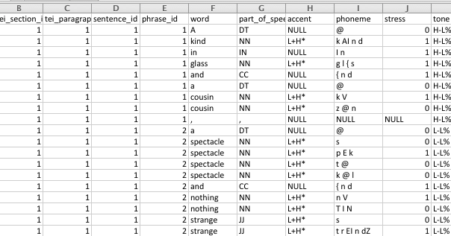
A sample of the tabular output of Tender Buttons by Gertrude Stein created within Meandre

Slide 70
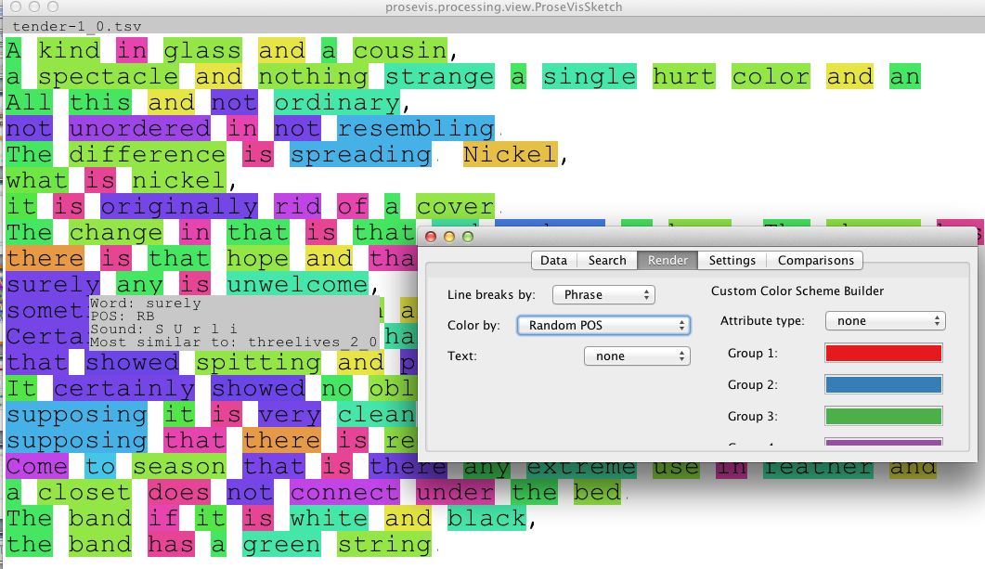
ProseVis : Parts of Speech
http://tclement.ischool.utexas.edu/ProseVis

Slide 71
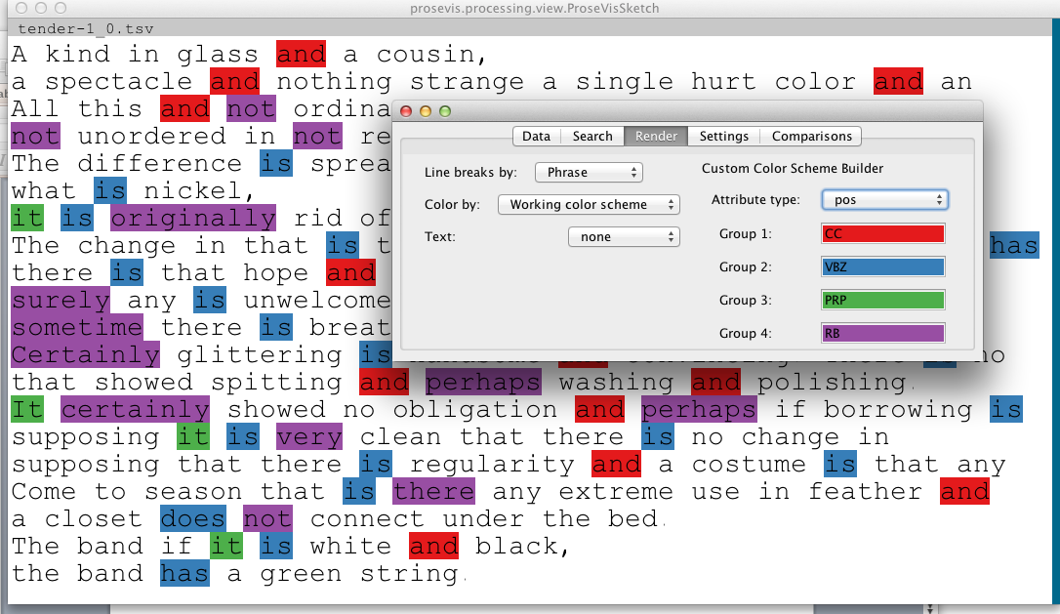
ProseVis : Parts of Speech
http://tclement.ischool.utexas.edu/ProseVis

Slide 72

ProseVis : Parts of Speech
http://tclement.ischool.utexas.edu/ProseVis

Slide 73

ProseVis : full sound
“Matisse”
“Picasso”

Slide 74

ProseVis : beginning sound
“Matisse”
“Picasso”

Slide 75

ProseVis : vowel sound
“Matisse”
“Picasso”

Slide 76

ProseVis : end sound
“Matisse”
“Picasso”

Slide 77

ProseVis: So?
“Matisse”
“Picasso”
From Matisse: “Some certainly were wanting to be needing to be doing what he was doing, that is clearly expressing something . . .”
From Picasso: “This one was one . . .”
Notes:
From Matisse: Some certainly were wanting to be needing to be doing what he was doing, that is clearly expressing something.

Slide 78
Matisse Portrait: Any one could come to be certain of this thing. Every one would come to be certain of this thing. This one was one, some were quite certain, one greatly expressing something being struggling. This one was one, some were quite certain, one not greatly expressing something being struggling.
Picasso: They were always following him. Some were certainly following him. He was one who was working. He was one having something coming out of him something having meaning. He was not ever completely working.

Slide 79
So? Parts of Speech
“If I Told Him,” “Matisse,” “Picasso,” and Three Lives, POS by sentence

Slide 80

Predictive Modeling: So?
Murphy, Margueritte S. “Familiar Strangers‘: The Household Words of Gertrude
Stein’s ’Tender Buttons.” Contemporary Literature 32.3 (1991): 383-402. 391.

Slide 81
So? Predictive modeling
Three Lives
Picasso Portrait
Odyssey
Iliad
The Making Of Americans
Tender Buttons
Matisse Portrait
New England Cook Book
Ulysses
Based on:
part of speech, accent, stress,
tone, and
break index

Slide 82
Process of data transformation through modeling.

Slide 83
“Confusion Matrix”
Created by Loretta Auvil at SEASR.
Notes:
To focus the machine learning on prosody, we only used features in our first use case (explained below) that we felt best reflected prosody which include: part_of_speech, accent, stress, tone, and break_index. To further bias the system towards human performance, we selected a window size of fourteen phonemes, because it was the average phrase length and we felt that human prosody comparisons were being made at the phrase level.

Slide 84

“Alas”
Tender Buttons

Slide 85


Tender Buttons
New England Cook Book

Slide 86


Tender
Buttons

Slide 87

Tender
Buttons

Slide 88

“If I Told Him,” “Matisse,” “Picasso,” and Three Lives, Comparison Data by sentence

Slide 89

Bonduca by Fletcher
Henry IV
Henry VIII
“Bonduca” by Fletcher; Henry IV, Part One, Henry VIII compared w/HVI, p1-3
(red=HIV, yellow=HVIp2, lblue=HVIII, dblue=HVIp1, green = bonduca)

Slide 90

Three Lives: Stories of The Good Anna, Melanctha and The Gentle Lena (1903) Compared to Oral Histories from Documenting the American South

Slide 91
First-Person Narratives, Documenting the American South
Journal of Margaret Ann Morris Grimball, 1810-1881
Pringle, Elizabeth Waties Allston, 1845-1921 A Woman Rice Planter
Jacobs, Harriet A. (Harriet Ann), 1813-1897
Incidents in the Life of a Slave Girl. Written by Herself: Electronic Edition. Wood, Henry, Mrs., 1814-1887
East Lynne, or, The Earl's Daughter. Laura Elizabeth Lee Battle Forget Me Nots of the Civil War
Wyeth, John A. (John Allan), 1845-1922 With Sabre and Scalpel; the Autobiography of a Soldier and Surgeon

Slide 92
Algorithmic Criticism–
Clement, T., Tcheng, D., Auvil, L., Capitanu, B., and Barbosa, J. “Distant Listening to Gertrude Stein’s ‘Melanctha’: Using Similarity Analysis in a Discovery Paradigm to Analyze Prosody and Author Influence. LLC: The Journal of Digital Scholarship in the Humanities 28.4 (2013): 582-602.
Clement, T. “Distant Listening: On Data Visualisations and Noise in the Digital Humanities.” Text Tools for the Arts. Digital Studies / Le champ numérique. 3.2 (2012).
Clement*, T., Tcheng, D., Auvil, L., Capitanu, B. Monroe, M. “Sounding for Meaning: Using Theories of Knowledge Representation to Analyze Aural Patterns in Texts.” digital humanities quarterly 7.1 (2013).

Slide 93
Conclusions
“I began to wonder at about this time just what one saw when one looked at anything really looked at anything. Did one see sound, and what was the relation between color and sound, did it make itself by description by a word that meant it or did it make itself by a word in itself.”
Stein, G. “Portraits and Repetition.” Lectures in America. London: Virago (1988): 165-206: 191.

